Slide 1
ECE408 Fall 2015 Applied Parallel Programming Lecture 12 Parallel Computation Patterns – Reduction Trees (Part 2)

Slide 2
A Sum Example
Thread 0
Thread 1
Thread 2
Thread 3
3
1
7
0
4
1
6
3
1
4
7
5
9
Active Partial Sum elements
2
11
14
3
25
steps

Slide 3
A Simple Thread Block Design
Each thread block takes 2* BlockDim input elements
Each thread loads 2 elements into shared memory
__shared__ float partialSum[2 * BLOCK_SIZE];
unsigned int tx = threadIdx.x;
unsigned int start = 2 * blockIdx.x * blockDim.x;
partialSum[t] = input[start + tx];
partialSum[blockDim + tx] = input[start + blockDim.x + tx];

Slide 4
The Reduction Step
unsigned int stride;
for (stride = 1; stride <= blockDim.x; stride *= 2) {
__syncthreads();
if (tx % stride == 0)
partialSum[2 * tx] += partialSum[2 * tx + stride];
}
Let’s think about __syncthreads placement?

Slide 5
Back to the Global Picture
Thread 0 in each thread block writes the sum of the thread block in partialSum[0] into a vector indexed by the blockIdx.x
There can be a large number of such sums if the original vector is very large
The host code may iterate and launch another kernel
If there are only a small number of sums, the host can simply transfer the data back and add them together.

Slide 6
Some Observations
No more than half of threads will be executing after the first step
All odd-index threads are disabled after first step
After the 5th step, entire warps in each block will fail the if test, poor resource utilization but no divergence.
Some warps will still succeed, but with divergence since only one thread will succeed
What’s the difference between a warp with some active threads, and a warp with no active threads?
Also, examine the memory reference pattern to shared memory… lots of conflicts to shared memory banks

Slide 7
A Better Strategy
Always compact the partial sums into the first locations in the partialSum[] array
Fewer conflicts to shared memory banks
Keep the active threads consecutive
Less divergence!

Slide 8
An Example of 16 threads
Thread 0
Thread 1
Thread 2
Thread 14
Thread 15
0
1
2
3
…
13
14
15
16
17
18
19
0+16
15+31

Slide 9
A Better Reduction Kernel
unsigned int stride;
for (stride = blockDim.x; stride > 0; stride = stride / 2) {
__syncthreads();
if (tx < stride)
partialSum[tx] += partialSum[tx + stride];
}

Slide 10
A Quick Analysis
For a 1024 thread block
No divergence in the first 5 steps
1024, 512, 256, 128, 64, 32 consecutive threads are active in each step
The final 5 steps will still have divergence

Slide 11
Parallel Algorithm Overhead
__shared__ float partialSum[2 * BLOCK_SIZE];
unsigned int tx = threadIdx.x;
unsigned int start = 2 * blockIdx.x * blockDim.x;
partialSum[tx] = input[start + tx];
partialSum[blockDim + tx] = input[start + blockDim.x + tx];
unsigned int stride;
for (stride = blockDim.x; stride > 0; stride = stride / 2) {
__syncthreads();
if (tx < stride)
partialSum[tx] += partialSum[tx + stride];
}

Slide 12
Parallel Execution Overhead
3
1
7
0
4
1
6
3
+
+
+
+
Although the number of “operations” is N, each “operation involves much more complex address calculation and intermediate result manipulation.
If the parallel code is executed on a single-thread hardware, it would be significantly slower than the code based on the original sequential algorithm.
4
7
5
9
+
+
7
6
+
7

Slide 13
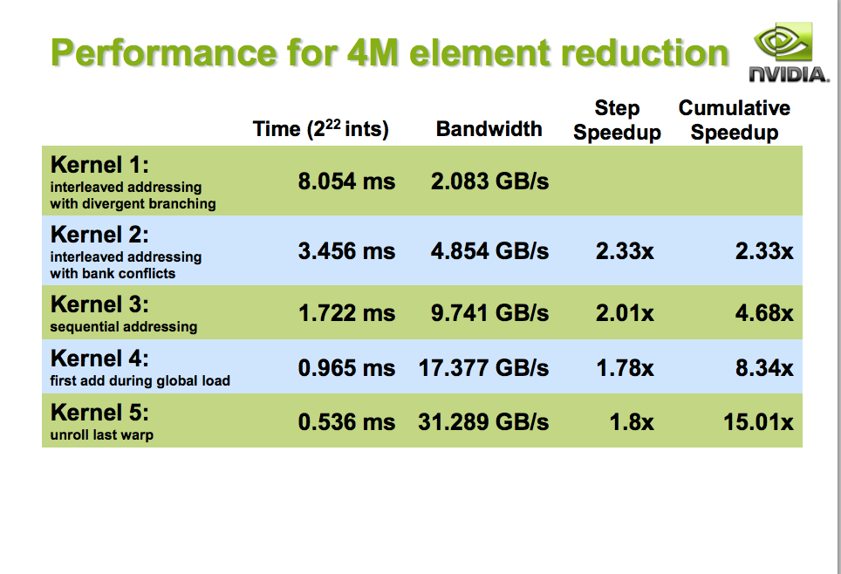

Slide 14
Any More QUESTIONS? Read Section 6.1

